Slide 1
Eligibility on the Web Portal
Conduent
Government Healthcare Solutions

Slide 2
Purpose
The purpose of this workshop is to provide an overview of the eligibility inquiry selection on the New Mexico Medicaid Web Portal in order to get the best possible information.
Obtaining the most current eligibility response will improve billing practices by reducing claim denials and unpaid services.

Slide 3
Objectives
We will review the following inquiries and Category of Eligibility (COE) portal results:
Eligibility Inquiry
Lock-In for Managed Care / Other
Intermediate Care Facilities/Individuals with Intellectual Disabilities (ICF/IID)
Level of Care
Qualified Medicare Beneficiary (QMB)
QMB Recertification
Specified Low-Income Medicare Beneficiary and Qualifying Individual (SLIMB and QI)
Avoiding Loss of Revenue
Alternative Benefit Plan (ABP)
Web Portal Visuals of Various Eligibility Screens

Slide 4
Eligibility Inquiry
Conduent
Government Healthcare Solutions

Slide 5
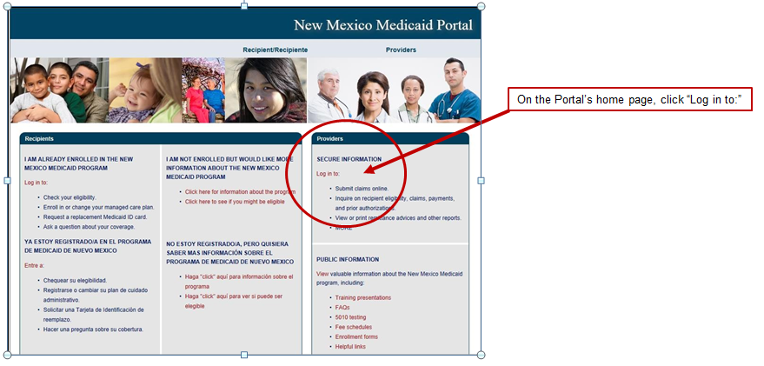
Medicaid Web Portal Login
https://nmmedicaid.portal.conduent.com/static/index.htm

Slide 6
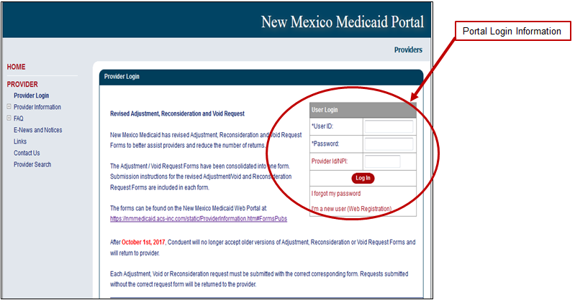
How to Register

Slide 7
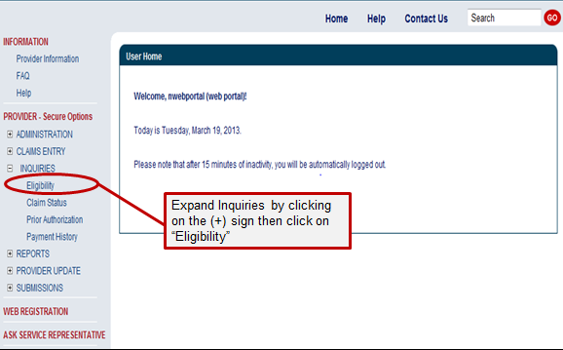
Eligibility Inquiry

Slide 8
Initiating the Eligibility Inquiry
The system will default to today’s date for the date of service (DOS). You can use any DOS within the past 2 years. Date spans can also be used.
Recipients can be searched using one of the following:
Recipient ID (this is the “SSN” style ID number, Medicaid ID, temporary SSN etc. 942XXXXXX),
SSN and date of birth, or
Last name, first name, date of birth (information needs to match what is in the eligibility system)
Notes:
What you need to conduct eligibility inquiries via the NM Web Portal. Example of the eligibility record is found on the next slide.

Slide 9
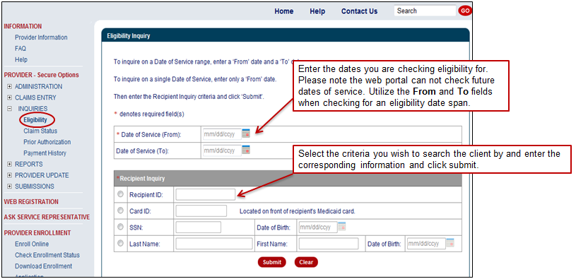
Checking Eligibility on the Web Portal
To check client eligibility, click Eligibility under “Inquiries” when logged in to your account.

Slide 10
Eligibility Inquiry continued
Category of Eligibility (COE) and description
Services description and if there are service limitations
Re-certification dates for COE, if they are processed by ISD.
Other Agencies may process re-certifications for some COEs and those re-certification dates may not be reflected in the portal, such as:
Supplemental Security Income (SSI) 001, 003, 004 – recertification dates are determined by the Social Security Administration (SSA)
COE 037 Adoption Subsidy Medicaid recertification dates are determined by Children, Youth and Families Division (CYFD)

Slide 11
Eligibility Inquiry continued
Lock-ins for Managed Care information
Program-All Inclusive Care of the Elderly (PACE) - The PACE program recipients qualify for nursing home care, but that care is received at their place of residents
Hospice - Services that provide palliative and supportive services to meet the physical, psychological and spiritual needs of terminally ill Medicaid recipients and their families
Medicare information
Third Party Liability (TPL) information
Long Term Care (LTC) information, IF there is a long term care span on file for the date entered
Some COEs require a level of care such as Institutional Care Medicaid (ICM) and waiver categories

Slide 12
Eligibility Inquiry continued
If there is LTC, there may be a patient pay amount, primarily for ICM categories
Prior Authorization (PA). Only the provider authorized for the service(s) will have access to the PA information as related to the eligibility record

Slide 13
Centennial Care Managed Care Organizations (MCOs)
Reminder: Recipients who are enrolled in Centennial Care, will have their claims submitted directly to the Managed Care Organization they have chosen. Below is the contact information for those MCOs.
Centennial Care MCOs | Contact Number | Website
BlueCross BlueShield of New Mexico | (866) 689-1523 | www.bcbsnm.com/community-centennial/
Presbyterian | (888) 977-2333 | www.phs.org
Western Sky Community Care | (844) 543-8996 | www.westernskycommunitycare.com

Slide 14
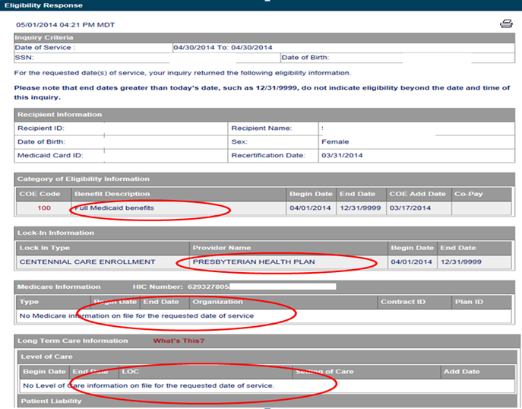
Eligibility Inquiry

Slide 15
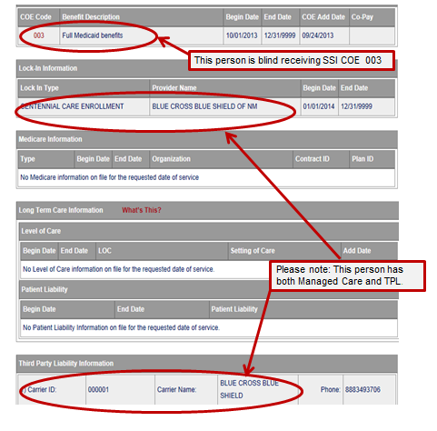
Eligibility Inquiry continued

Slide 16
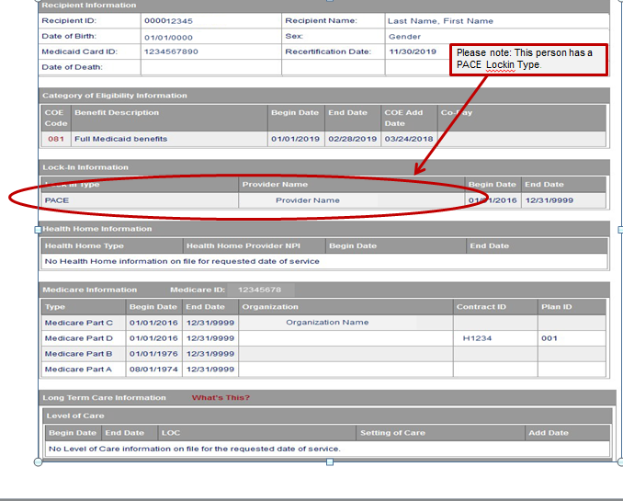
Eligibility Inquiry continued

Slide 17
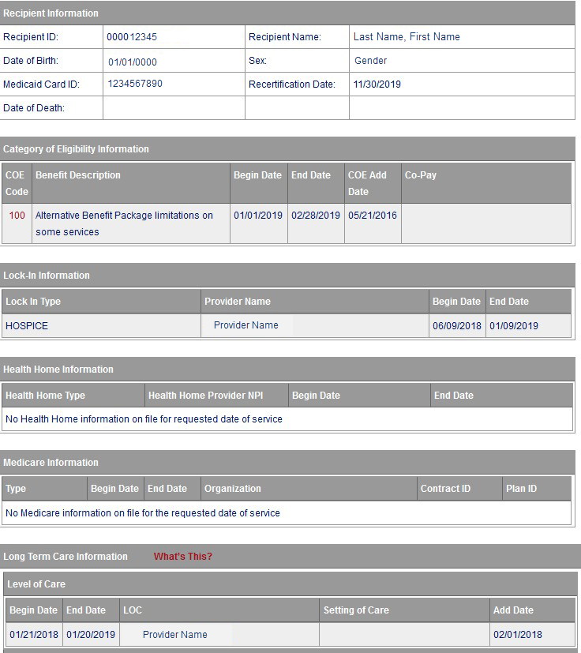
Eligibility Inquiry continued
Please note: This person has HOSPICE Lockin Type.

Slide 18
ICF/IID Eligibility Specific
Conduent
Government Healthcare Solutions
Notes:
Intermediate Care Facilities/Individuals with Intellectual Disabilities (ICF/IID)

Slide 19
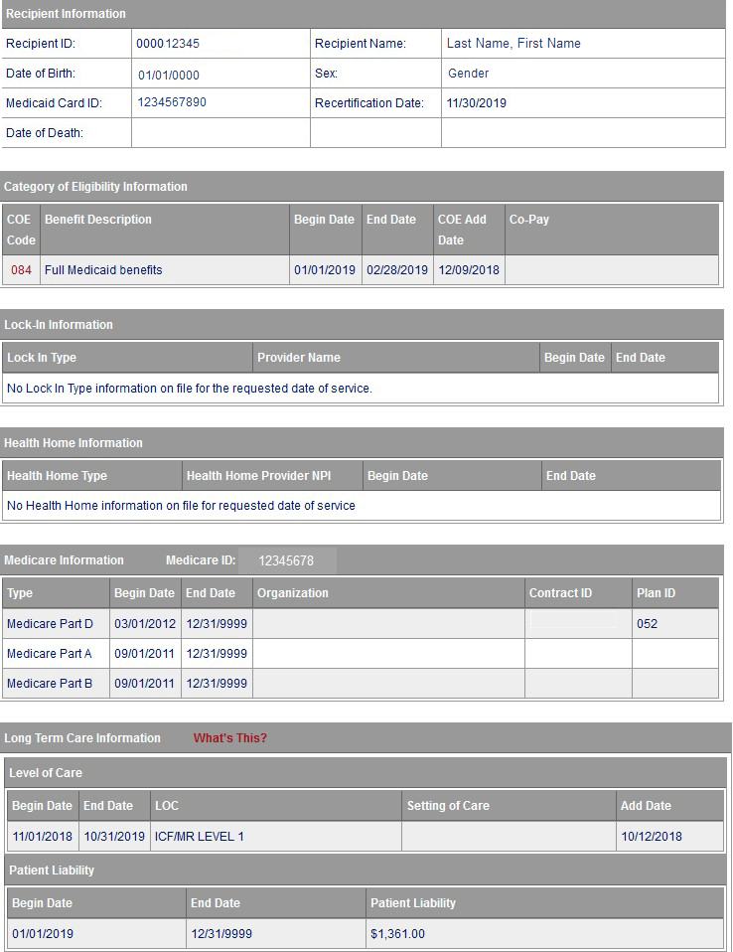
Here is where the recertification date can be found
The COE Code, Begin/End Date, and the COE Add Date can be found here
This example shows ICF/IMR Level of Care. Please be aware there also could be Nursing Facility Level of Care (NFL) or other types depending on the recipient’s COE. This field can also be blank IF the COE does not require a Level of Care
Notes:
Last screenshot to be replaced.

Slide 20
QMB Eligibility
Conduent
Government Healthcare Solutions

Slide 21
QMB
Must receive Medicare Part A
Income is under 100% Federal Poverty Level (FPL)
Medicaid dollars pay for the monthly Medicare premium
Medicaid also covers deductibles and any co-pays, it is not full coverage Medicaid
COE 041 if person is 65 or over
COE 044 if person is under age 65

Slide 22
QMB
Provided a blue Medicaid card
A participant with COE 41 or 44 is not eligible for an MCO
There is no Level of Care required
QMB recipients may also receive COE 29 Family Planning automatically
Always check the Medicaid portal for current information

Slide 23
QMB Special Eligibility Rules
Most Medicaid COEs begin coverage in the month the member applies, if approved QMB begins the following month, not the month of application per NMAC 8.240.600.11
Example: If someone applies in 12/18 and is approved in 12/18, the first month of benefits is 01/19
There is no retroactive coverage for QMB per NMAC 8.240.600.11

Slide 24
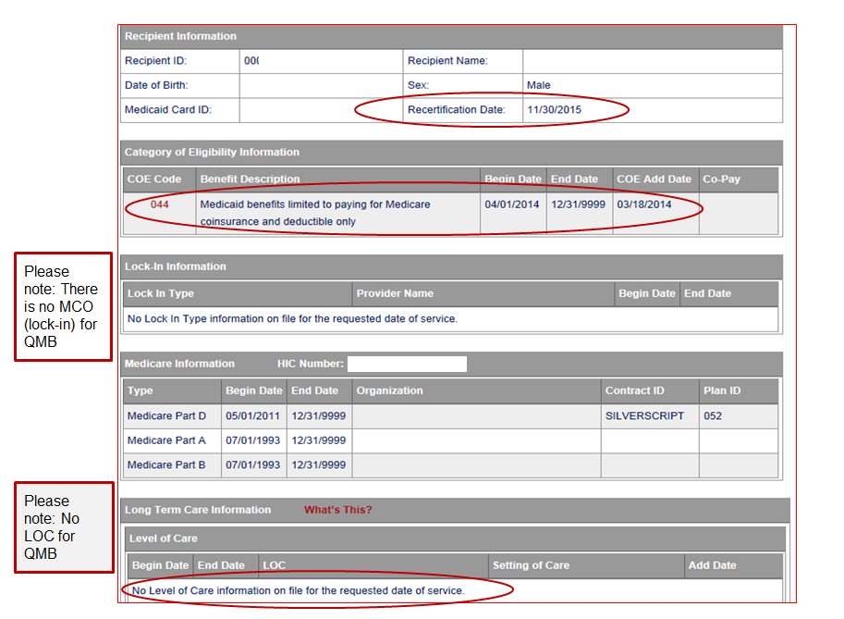

Slide 25
QMB Recertification
Conduent
Government Healthcare Solutions

Slide 26
QMB Recertification
Recipients must re-certify annually (meaning a new application is sent to ISD)
If a client fails to re-certify timely, the QMB case will expire
Recipients will be notified 45 days in advance of the expiration date

Slide 27
SLIMB and QI Eligibility
Conduent
Government Healthcare Solutions
Notes:
Specified Low-Income Medicare Beneficiary and Qualifying Individual (SLIMB and QI)

Slide 28
SLIMB and QI
Both use COE 042 and 045
Must have Medicare Part A
Must be between 100% to 120% of FPL for SLIMB
Must be between 120% to 135% FPL for QI
Covers only Medicaid paying the monthly Medicare Part B premiums
COE 042 and 045 will not show on the portal, providers can bill Medicare but not Medicaid
The individual does not receive a blue Medicaid card for either of these categories
Always check the Medicaid portal for current information

Slide 29
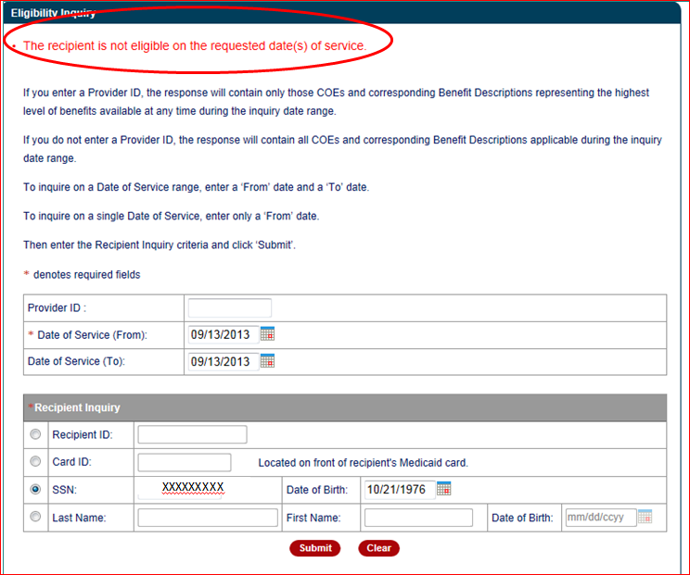
Not Eligible
Notes:
Example for SLIMB and QI

Slide 30
Avoiding Loss of Revenue
Conduent
Government Healthcare Solutions

Slide 31
Avoiding Loss of Revenue
Check the web portal routinely, verify the re-certification date. Contact Provider Relations at 800-299-7304, for questions.
Encourage the client to apply through the web portal or fill out another application to take to Income Support Division (ISD). Clients may contact ISD at 800-283-4465 for application assistance.

Slide 32
Avoiding Loss of Revenue Due to QMB Recertification
Exception Code 0143 (client not eligible)
If you see code 0143 on the RA, check the web portal for the recipient’s eligibility for that DOS.
Note: A client may have lost their QMB coverage if they failed to re-certify.
In some case, clients may not have approval for the month of the application but will have QMB the following month.
Example: Client is due for recertification by 11/30/18
Client re-applies for QMB coverage in December of 2018. The approval date will then be January of 2019, creating a loss of coverage for the month of December.
Notes:
Example of possible denied services due to client not eligibility for QMB.

Slide 33
Alternative Benefit Plan (ABP)
Conduent
Government Healthcare Solutions

Slide 34
Alternative Benefit Plan (ABP) for Other Adult Group COE 100
For adults age 19 through 64:
2 Types of Services Plans
Alternative Benefit Plan some limitations on services
Some recipients will have small co-pays for dates 2018 and earlier depending on their income
Alternative Benefit Plan Standard (full) Medicaid
Recipients who may have special needs
Recipients will need to contact their Centennial Care Managed Care Plan
Note: the Centennial Care MCO determines if they qualify for the standard Medicaid plan. The ABP Benefits and Limitations of Services can be found here: NMAC 8.309.4

Slide 35
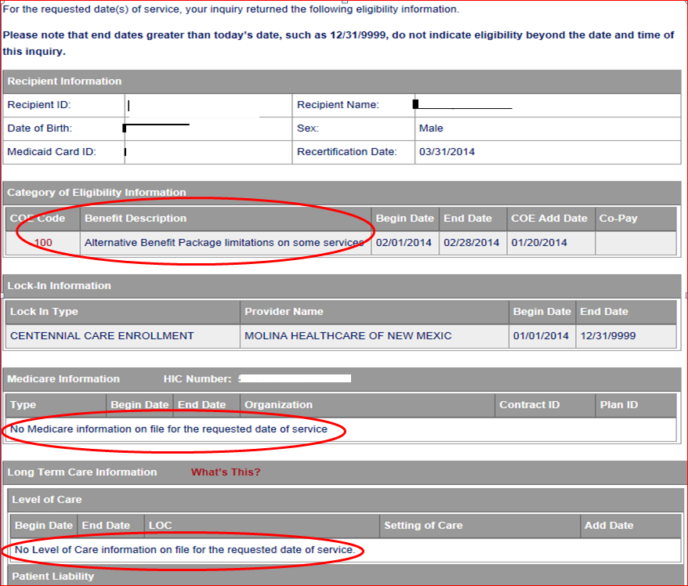
Eligibility Inquiry COE 100

Slide 36
Web Portal Visuals of Various Eligibility Screens
Conduent
Government Healthcare Solutions
Notes:
Overview

Slide 37
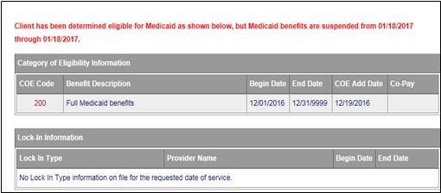
Justice-Involved Utilization of State Transitioned (JUST) Eligibility
The client’s eligibility will be suspended for the date-of-service that you’re looking for.
Below is an example of the red text that will be seen above the Category of Eligibility Information section. The COE displayed is the eligibility that is in place for the recipient upon incarceration. If you feel this eligibility suspension is an error, please contact the Provider Relations Help Desk via phone call at (800) 299-7304 or contact the NM Provider Support email inbox at NMProviderSupport@conduent.com.
The JUST Health Program can be viewed here in detail: JUST Health Program

Slide 38
Eligibility Inquiry COE 100

Slide 39
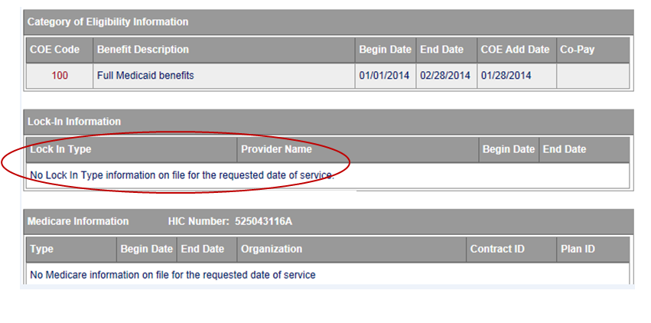
Example of COE 100 for full Medicaid, No Lock-In, No MCO

Slide 40
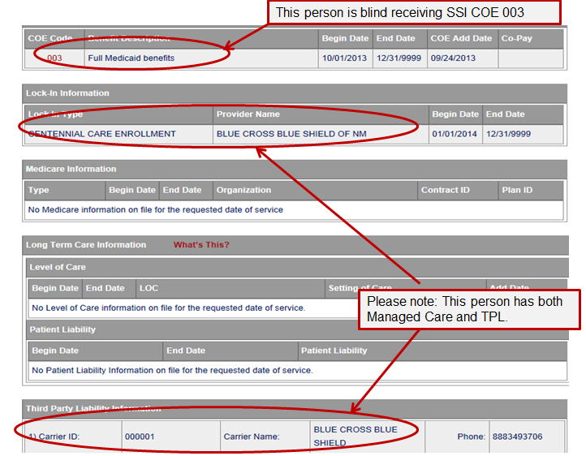
Eligibility Inquiry – Third Party Liability (TPL)

Slide 41
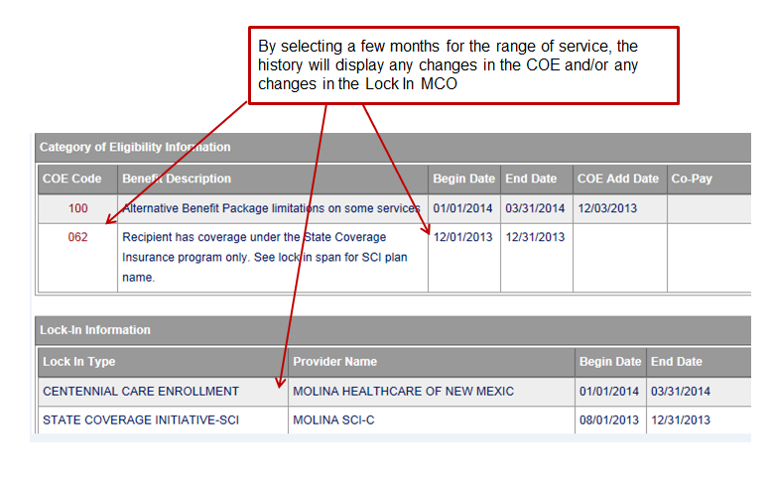
Eligibility History on the Portal

Slide 42
New Mexico Medicaid Resources
New Mexico Medicaid Online
Provider Information
Provider Login Screen Notices
Provider E-News Newsletters
Medicaid Provider Relations Call Center
Provider Communication Updates
Provider Field Representative
Provider Webinars
Open Forums and Live Training Sessions
Continued on next page . . .

Slide 43
New Mexico Medicaid Resources Continued
New Mexico Medicaid Portal – https://nmmedicaid.portal.conduent.com/static/index.htm
Claim Inquiries, Eligibility Verification, Electronic Claim Submission, Provider Manuals, E-News
NM Human Services Department – http://www.hsd.state.nm.us/mad/
Supplements, Memos, Provider Billing Packets and Policy
Medical Assistance Division – PE Program Staff – HSD.PEDeterminers@state.nm.us
Assistance with PE Applications, PE Determinations, MAD 070, PE Training, PE Certification
Conduent Provider Relations Call Center – (800) 299 - 7304 option 6 or (505) 246 - 0710 option 6.
Claim Status, Eligibility, Prior Authorization, Medicaid Updates
Conduent Provider Relations Helpdesk – NMProviderSUPPORT@conduent.com
Claim research assistance and general Medicaid inquiries
Conduent HIPAA Helpdesk – HIPAA.Desk.NM@conduent.com Assistance on NM Web Portal, EDI inquiries, and Online Claim Submission with DDE (Direct Data Entry)
Conduent Provider Enrollment Helpdesk - NMProviderSUPPORT@conduent.com
Provider Enrollment Applications, Forms & Instructions
NM Medicaid Recipient Helpdesk – (888) 997 – 2583 or (505) 247 – 1042
Eligibility inquiries, Fee-for-Service Replacement Medicaid Identification Card, Enroll or change a Managed Care Organization and Eligibility application status
Medical Assistance Division, Program Rules – http://www.hsd.state.nm.us/providers/rules-nm-administrative-code-.aspx
NMAC for Programs administered by the Medical Assistance Division Yes New Mexico - https://www.yes.state.nm.us/yesnm/home/index Apply, check, update, or renew Medical Assistance (Medicaid) benefits

